Slide 1

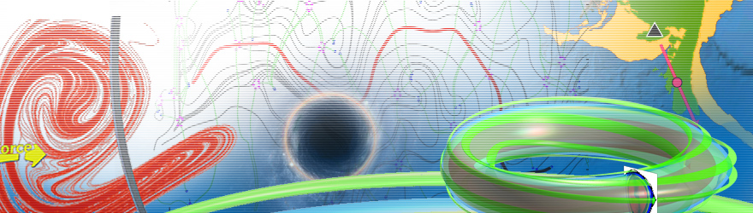
生物动力系统模拟
王冠宇 18665955633
wanggy@sustc.edu.cn

Slide 2
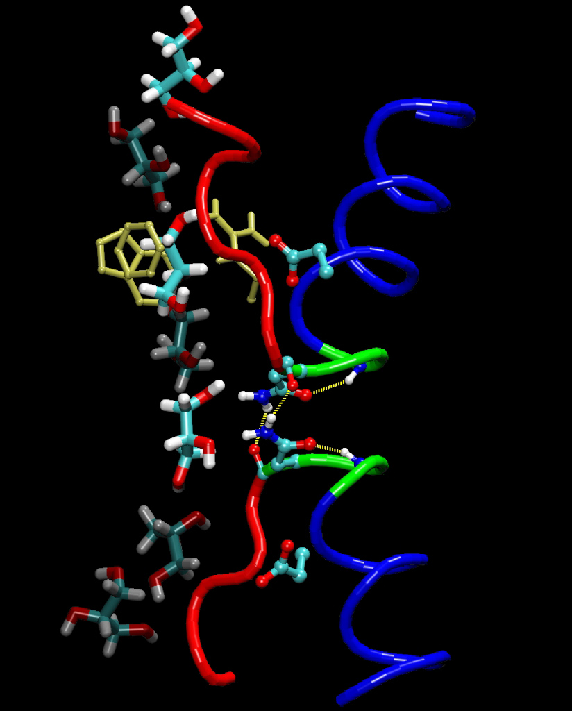
Molecular Dynamics Simulation

Slide 3
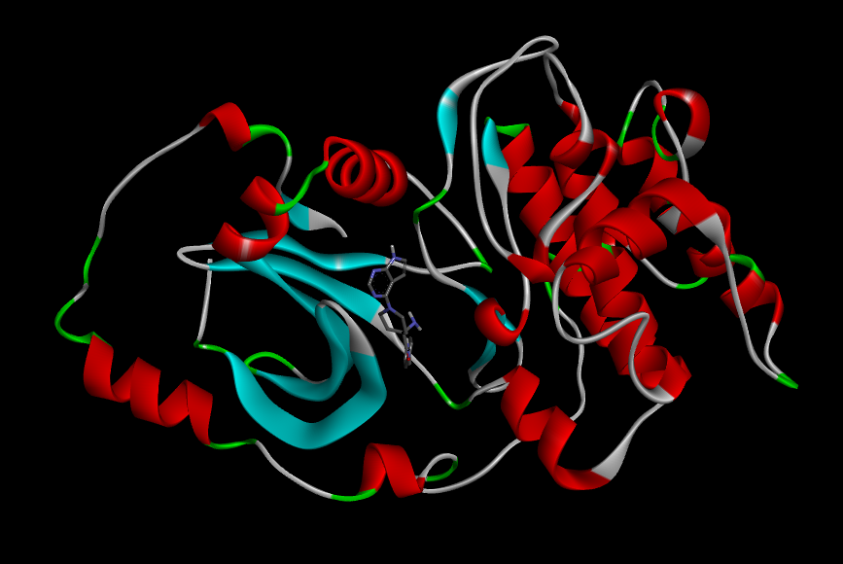
Homolog modeling
Protein together with inhibitor

Slide 4

Homolog modeling
Suppose you want to study human protein X
You search PDB database
https://www.rcsb.org/
Unfortunately you can only find mouse protein 2X39

Slide 5
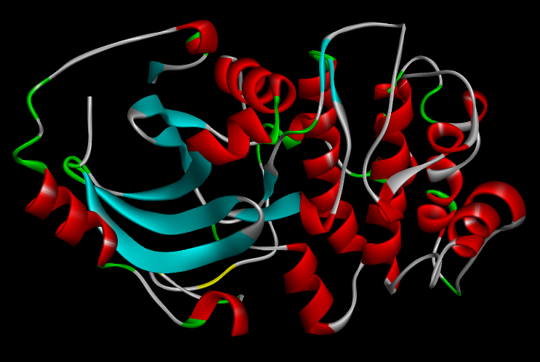
Fortunately, your major is biology so you know mouse X protein should be very similar to
human X, probably a few differences of residues
So you can just use mouse X structure, but just replace the different residues
Homolog modeling！
Then you do minimization to obtain a more realistic human X.

Slide 6
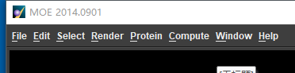
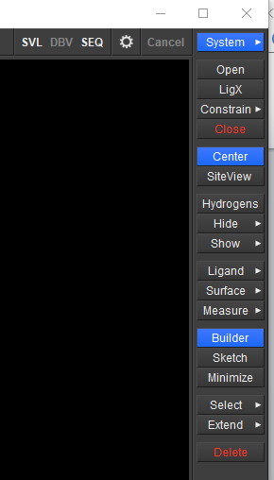
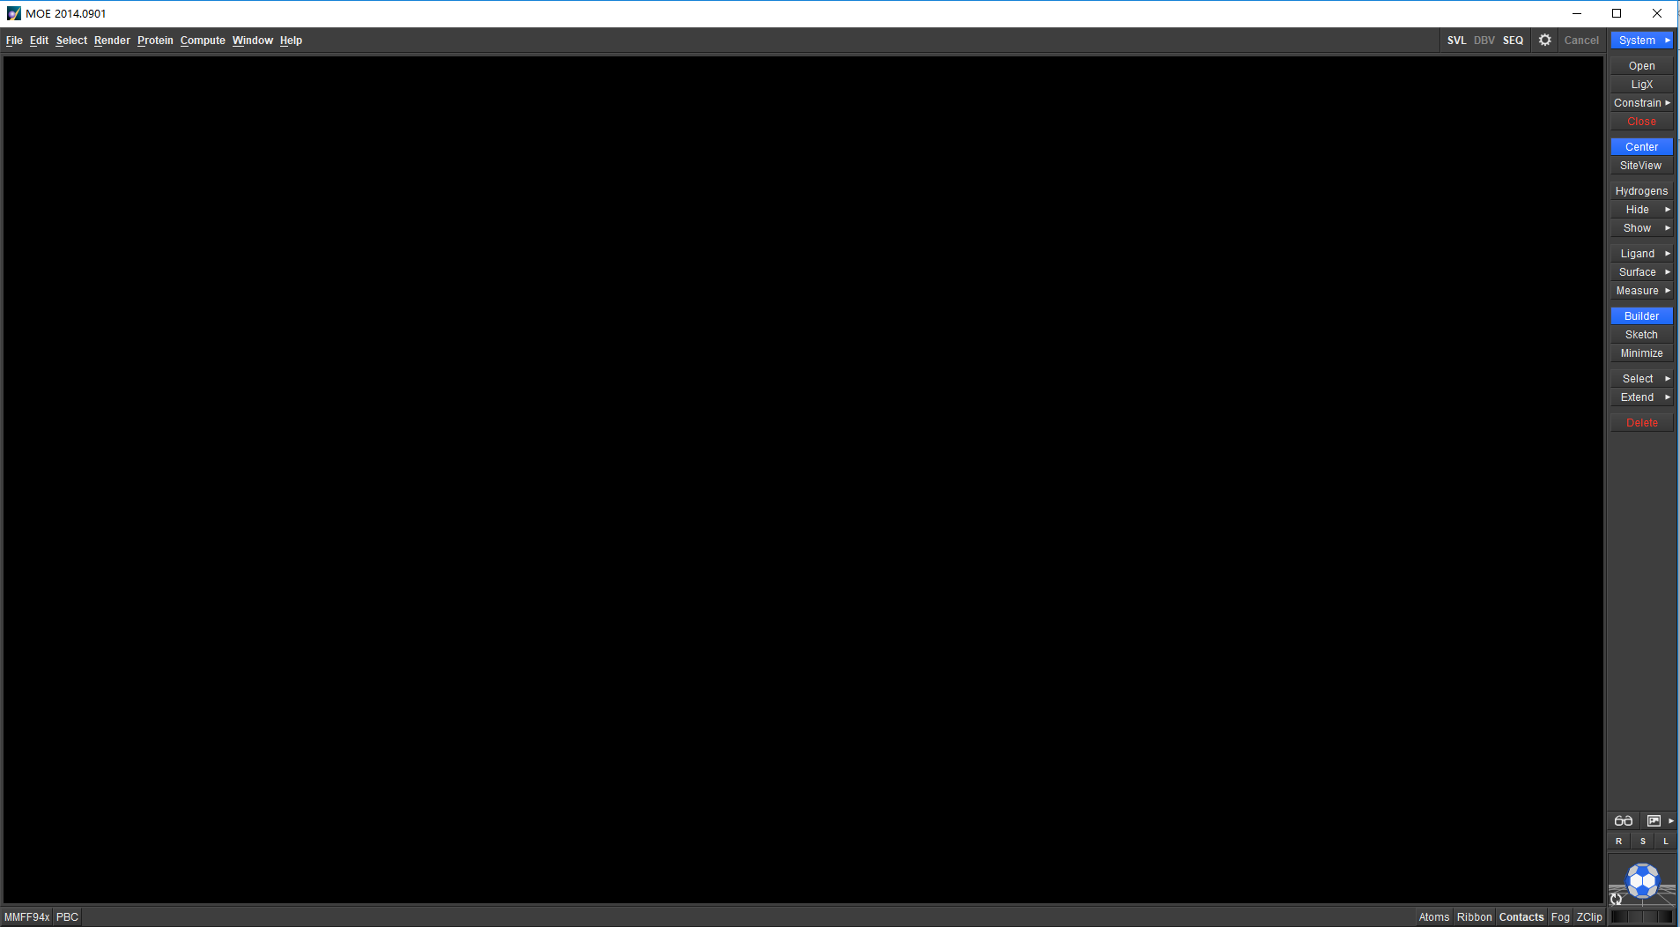
Many softwares can do homolog modeling, here we use MOE as an example.

Slide 7
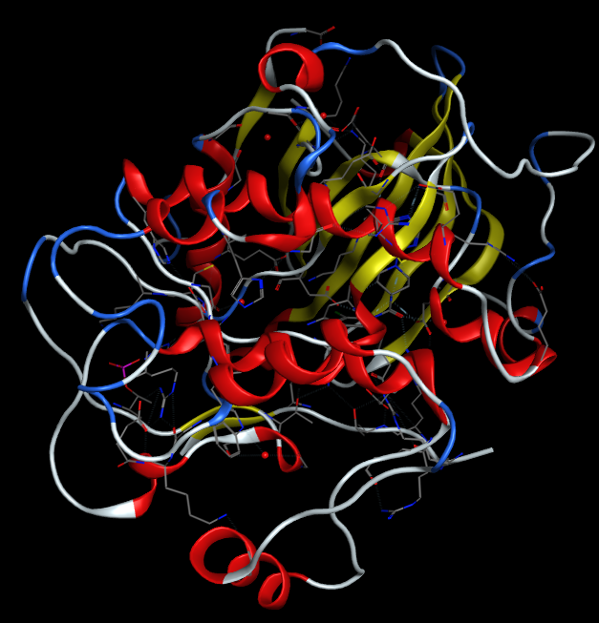
File → Open → X.pdb
You see that there are few unimportant chains, which should be deleted.
Description of the chains can often be found in the pdb file.
Check the file to determine things unwanted.

Slide 8
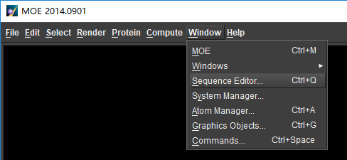
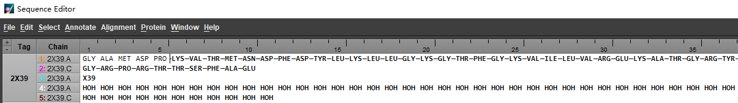
Delete the unwanted.
Click Windows → Sequence Editor

Slide 9
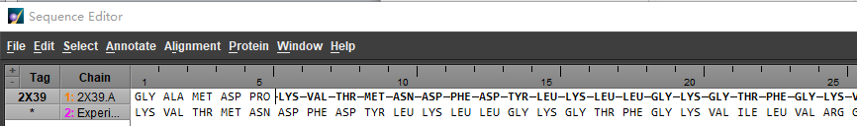
In Sequence Editor, open the human X amino acid sequence
File → Open → HumanX
Through procedures such as Alignment, make the two as similar as possible
Details are case dependent. You can always click Help

Slide 10
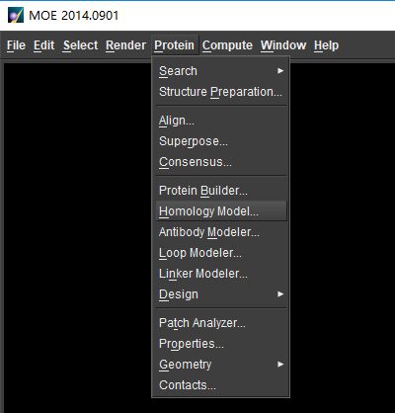
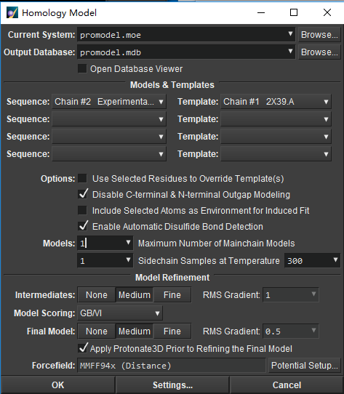

Homolog modeling begins …

Slide 11
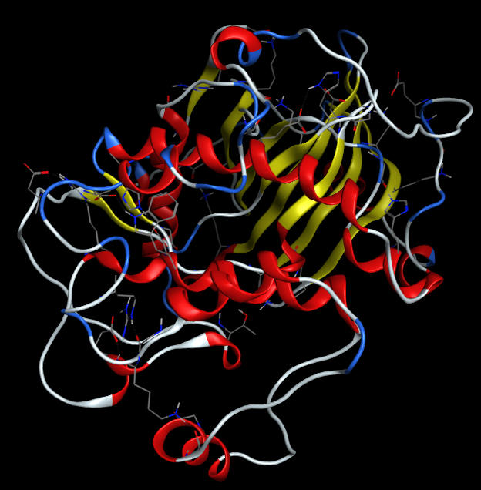
Save into HumanX.pdb
HumanX.pdb
X.pdb

Slide 12
Now we want to add an inhibitor to Human X protein
Of course, we would not inhibit a normal protein.
We only inhibit a mutated protein that may cause problems like cancer
So we first show how to mutate a amino acid
R129H
You can directly modify the pdb file (just change the residue #129 from ARG to HIS)
Or use a software

Slide 13
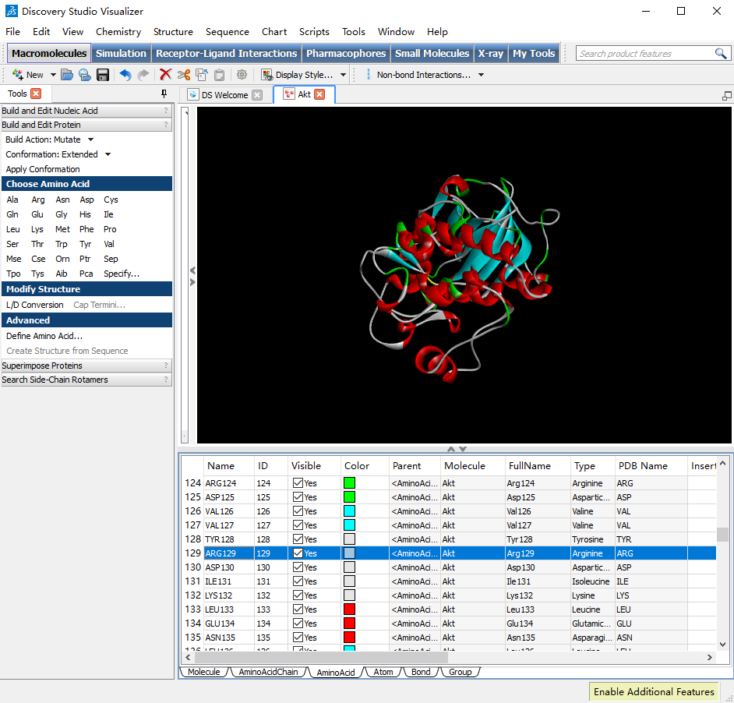

Slide 14
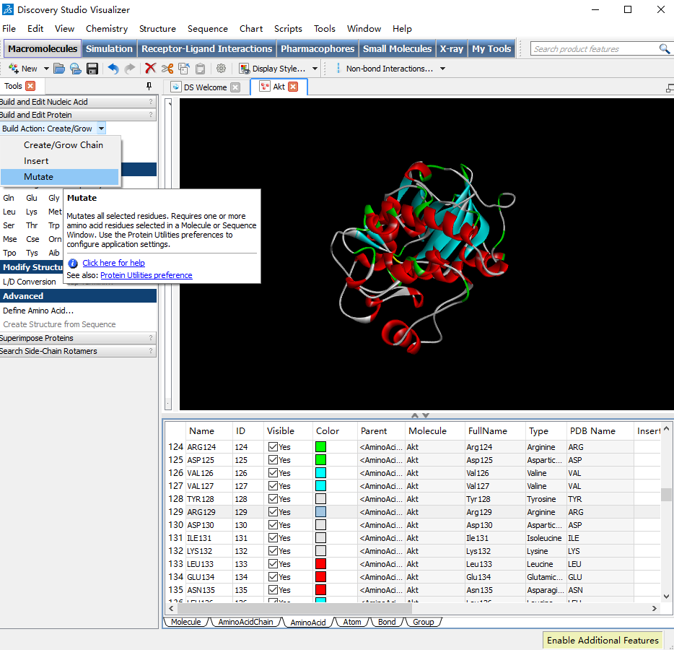

Slide 15
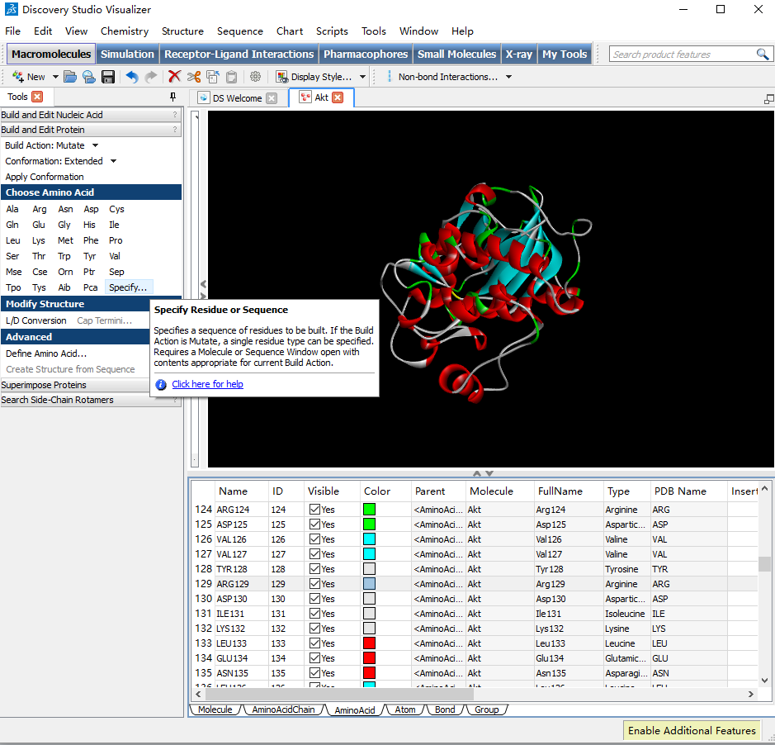
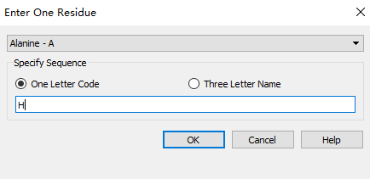
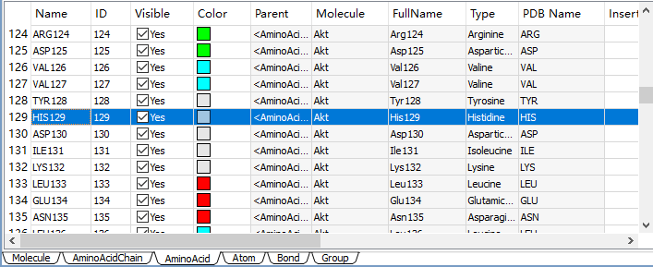

Slide 16
Now we want to add an inhibitor to Human X protein
Of course, we would not inhibit a normal protein.
We only inhibit a mutated protein that may cause problems like cancer
So we first show how to mutate a amino acid
R129H
You can directly modify the pdb file (just change the residue #129 from ARG to HIS)
Or use a software
Save the file into Xm.pdb

Slide 17
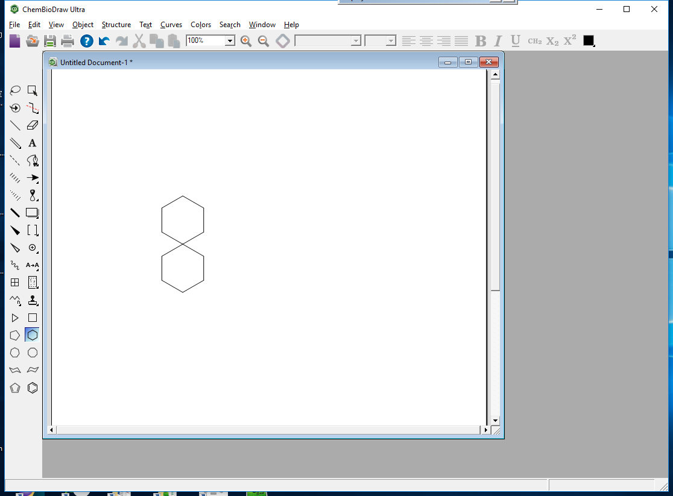
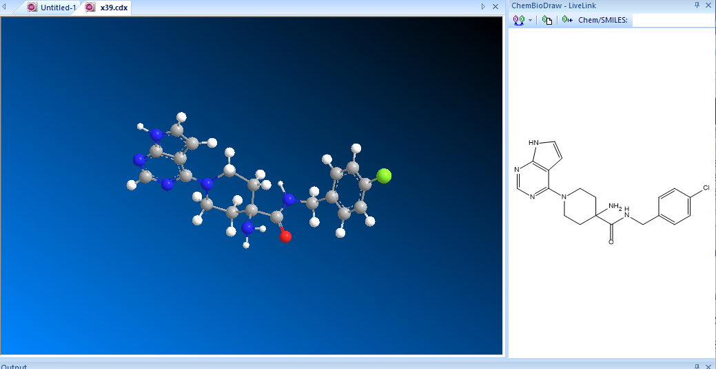
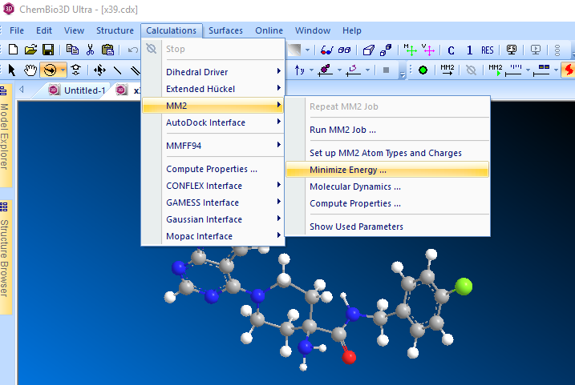
Now we design an inhibitor called inh
Firstly, use Chemdraw to draw the chemical structure of inh. Save it as inh.cdx.
You can use Chemdraw3D to
visualize the inhibitor
Minimization:
Calculations>MM2>Minimize Energy
Save inh.pdb

Slide 18
Now put inh.pdb into Xm.pdb (molecular docking)
inh.pdbqt
Xm.pdbqt
Q: partial charge T: atom type
XmInh.pdbqt
We use another software called AutoDockTools
Note that docking is a minimization process

Slide 19
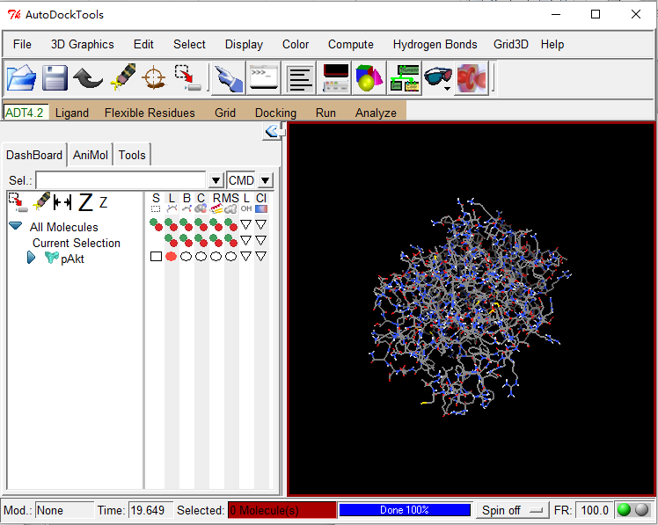
First, load Xm.pdb, after some operation, save it as Xm.pdbqt
File>Read Molecule
> Xm.pdb
Edit>Hydrogens
>add>polar only
Grid>macromolecule
>choose> Xm.pdb
(Grid is to define search space for the upcoming
docking; This step just specifies Xm.pdb as the receptor protein )
Save as Xm.pdbqt

Slide 20
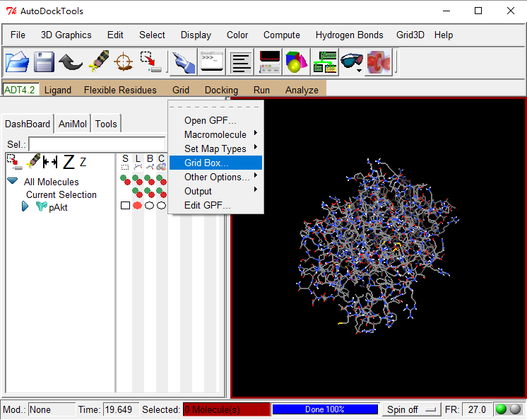
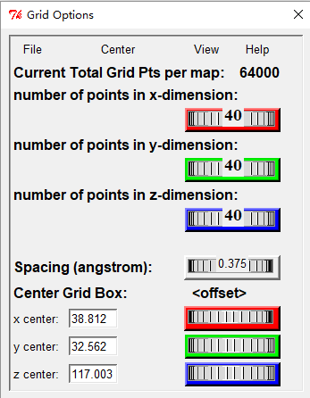
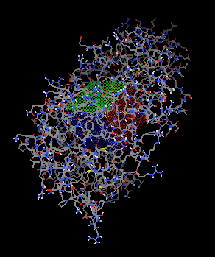
Now we use Grid to define the search space
Then we are going to define the searching space, click Grid>Gridbox, make sure the box can cover all the protein or at least the binding site area. Take note of the box size and box center, in the snapshot below, the box size is 100, 100, 100, the box center is 38.812, 32.562, 117.003. These numbers stand for the searching space and will be used in the following vina run.

Slide 21
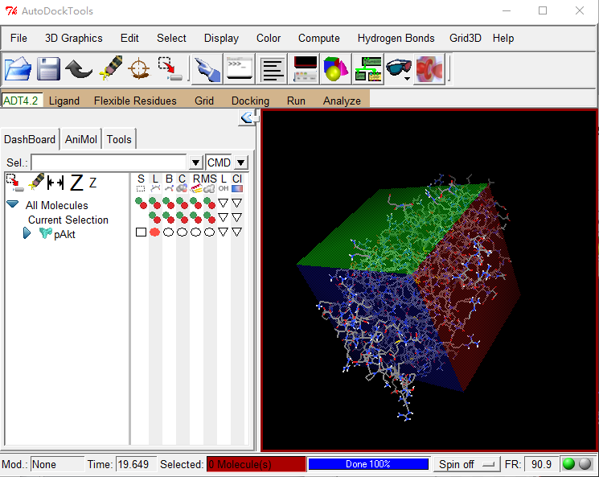
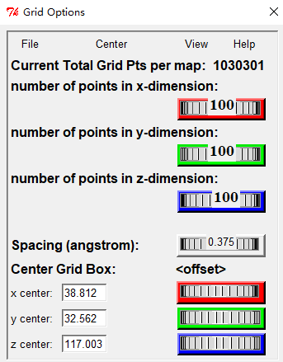
Write down the numbers

Slide 22
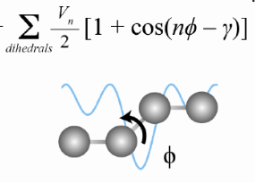
Load Inh.pdb, after some operation, save it as Inh.pdbqt
ligand>input>open
ligand>torsion Tree>
choose Torsions>Done
(Here all the torsion bonds are rotable;
There are options to make some bonds
Non-rotatable)
ligand>output>save as pdbqt

Slide 23
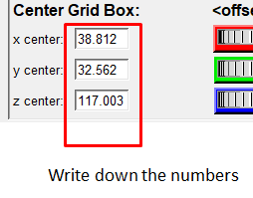
Now we do the docking …
$ vina --receptor Xm.pdbqt --ligand Inh.pdbqt
--center_x 38.812 --center_y 32.562 --center_z 117.003
--size_x 100 --size_y 100 --size_z 100 --log x39.log

Slide 24
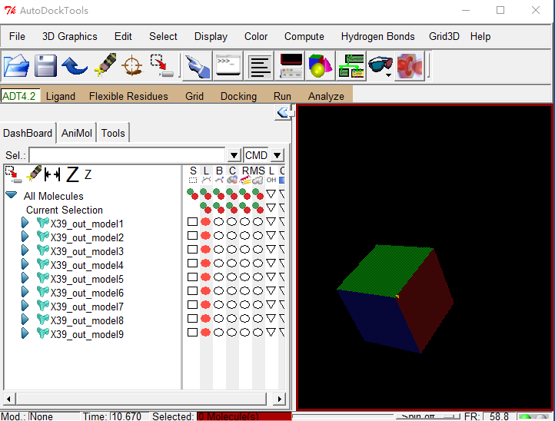
After a while, a new file Inh_out.pdbqt is generated, which contains 10 best inhibitors.
We usually choose the first one Inh_out_model1.pdb as the best of the best.

Slide 25
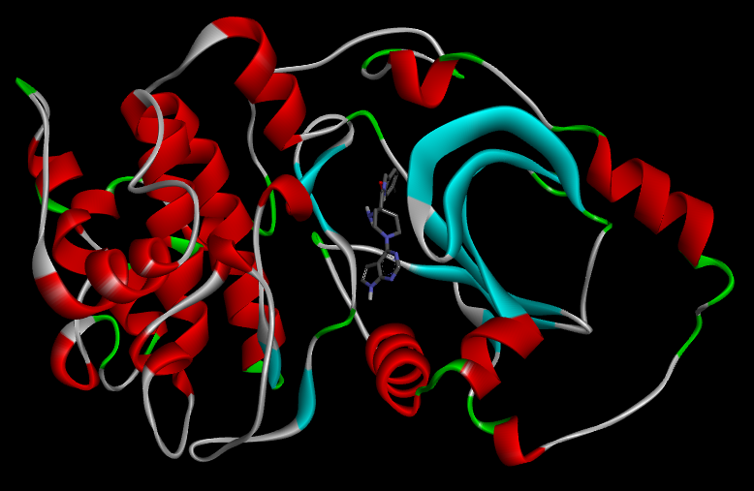
Now we can produce the complex
cat Inh_out_model1.pdb Xm.pdb > XmInh.pdb
cat A B > C is just a linux command to merge files A and B into C
Alternatively, you can do it by using text editor and copy paste.
XmInh.pdb

Slide 26
Generate a force field for the inhibitor
With XmInh.pdb, one can begin MD simulation, following the same procedure as the last class.
But there is a problem, i.e., there is no force field for the ligand.
Amber has two steps to produce a force field file *.frcmod
$ antechamber -i Inh.pdb -fi pdb -o Inh.mol2 -fo mol2 -c bcc -s 2
$ parmchk -i Inh.mol2 -f mol2 -o Inh.frcmod

Slide 27
Generate a library file Inb.lib for the inhibitor
Generalized AMBER Force Field, a set of parameters used in simulating the interactions of small organic molecules
$ source leaprc.gaff
$ Inb = loadmol2 x39.mol2
$ check Inb
$ loadamberparams Inb.frcmod
$ saveoff Inb Inb.lib

Slide 28
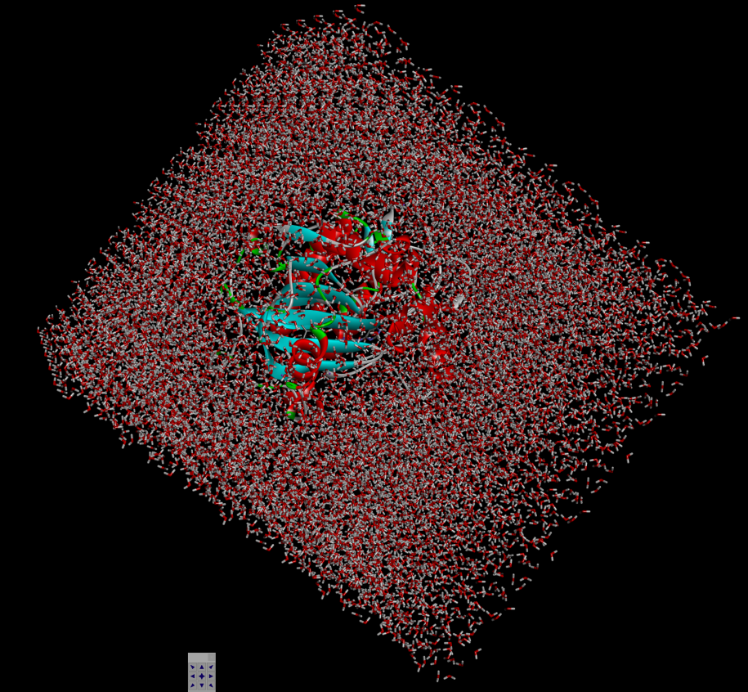
Use xLeap to prepare: solvation, generating prmtop and inpcrd file
source leaprc.protein.ff14SB
source leaprc.gaff
source leaprc.water.tip3p
loadoff Inh.lib
x = loadpdb XmInh.pdb
check x
addIons x Na+ 0 #neutralize the system
solvatebox x TIP3PBOX 10.0 #add tip3p water model in the system
savepdb x XmInhBox.pdb
saveamberparm x XmInh.prmtop XmInh.inpcrd
quit

Slide 29
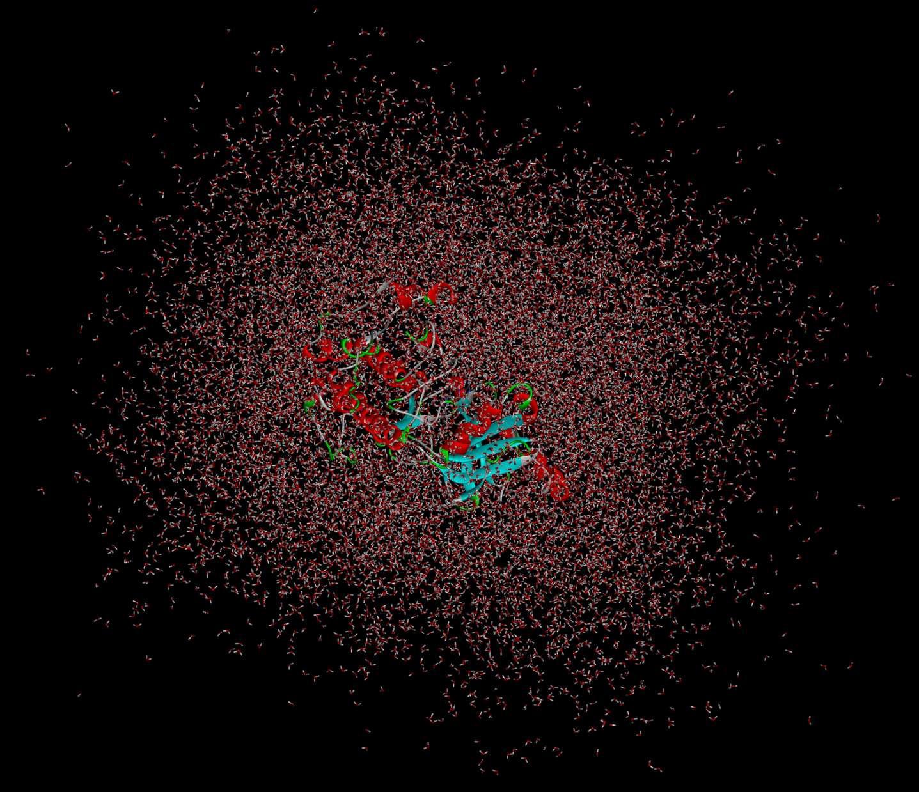
Minimizing, Heating, Production
Prod.pdb

Slide 30
Minimizing, Heating, Production
Prod.nc
Tajectory file. Can show the simulation in VMD but not usual video player.
Prod.mpg
After conversion. It now can be played by standard video player.
ProdNoWater.mpg

